Slide 1
PISA 2018 Report for Bosnia and Herzegovina
Sarajevo, 3 december 2019
Žaneta Džumhur, chief analyst

Slide 2
PISA 2018 in Bosnia and Herzegovina
- BiH has participated in PISA survey for the first time - Sample included 6 480 of fifteen-year-old students - 3 148 girls and 3 332 boys - 213 primary and secondary schools

Slide 3
Sample of schools
No. | Canton/ Entitety/ Region/ District | Primary schools | Secondary schools
 | Federation/ CANTONS
1. | Bosnian-Podrinje Canton Goražde | 2 | 3
2. | Canton 10 | 3 | 2
3. | Hercegovina-Neretva Canton | 5 | 9
4. | Canton Sarajevo | 9 | 15
5. | Central Bosnia Canton | 1 | 9
6. | Tuzla Canton | 11 | 16
7. | Una-Sana Canton | 9 | 10
8. | Zenica-Doboj Canton | 9 | 13
9. | Posavina Canton | 4 | 3
10. | West Herzegovina Canton | 2 | 3
 | Republika Srpska/ REGIIONS
1. | Banja Luka | 9 | 12
2. | Bijeljina | 2 | 5
3. | Birač | 5 | 3
4. | Doboj | 2 | 7
5. | Hercegovina | 4 | 3
6. | Prijedor | 5 | 7
7. | Sarajevo-Romanija | 2 | 4
 | Brčko District BiH | 1 | 4

Slide 4
Testing structure
- the students worked on the computer for two hours taking the test in reading, math and science
- after that they completed a questionnaire for about 35 minutes
- two types of questionnaires - for the school and for the students
- students with disabilities who can respond to test conditions took so called One hour testing (instructions and tests are shorter than regular instruments)

Slide 5
Distribution of 15-year-olds in BiH by grades
- PISA tests the students who are between 15 and 3 months old and 16 and 2 months old at the time of assessment - In BiH, the total exclusion rate is less than 3%

Slide 6
BiH in PISA 2018 - Results Student Achievements
In Bosnia and Herzegovina, mean achievement in
mathematics is 406, in reading 403, and in science 398 score points,
which is below the OECD average
The difference in average achievement in Bosnia and Herzegovina in mathematics, according to the OECD average, is 83 score points, 85 in reading and 91 in science,
WHICH IS, ON AVERAGE, THE DIFFERENCE OF
THREE YEARS OF SCHOOLING
FOR ALL THREE DOMAINS.

Slide 7
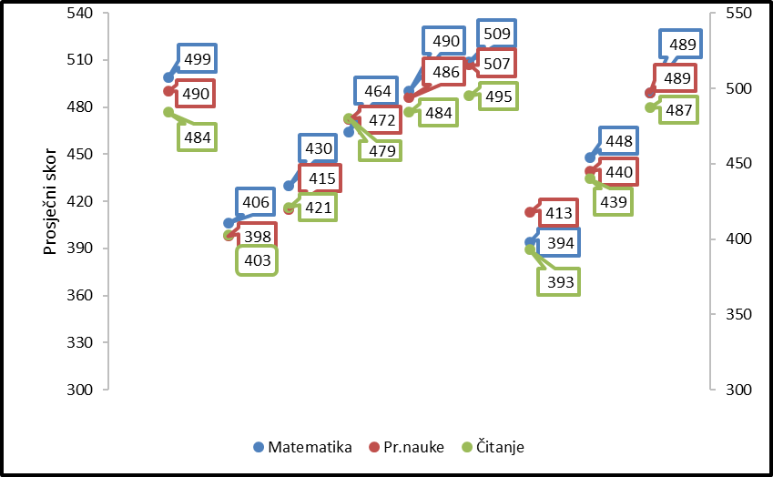
EU
Slovenia
OECD
Austria
Croatia
Montenegro
Serbia
Average score
N. Macedonia
BiH
Mathematics
Science
Reading

Slide 8
Levels of achievement
- PISA also describes student outcomes by level of knowledge separately in each area identifying the basic level of success (Level 2)
- it is considered the minimum level of proficiency in reading, mathematics and science
- For all three PISA areas, the basic level is one where students can access tasks that require, at least, minimal ability and aptitude for thinking independently

Slide 9
Levels of Achievement
Levels of Achievement | The lowest possible score
 | Reading | Mathematics | Science
1c | 189
1b | 262 |  | 261
1a (1) | 335 | 358 | 335
2 | 407 | 420 | 410
3 | 480 | 482 | 484
4 | 553 | 545 | 559
5 | 626 | 607 | 633
6 | 698 | 669 | 708

Slide 10
Minimal level of echievement is not reached by
58% pupils in mathematics, 54% in reading and 57% in science
while the OECD average is
24% pupils in mathematics, 23% in reading and 22% in science.

Slide 11
Achievements in reading

Slide 12
Achievements in Mathematics

Slide 13
Achievements in Science

Slide 14
Students with low and high scores
Levels of achievements | The lowest possible score/ percentage of students
 | Reading | Mathematics | Science
1c | 189 3% (and more 0,1% below N1c)
1b | 262 17% |  | 261 18% (and more 3% below N1b)
1a (1) | 335 33% | 358 29% (and more 29% below N1) | 335 36%
2 | 407 | 420 | 410
3 | 480 | 482 | 484
4 | 553 | 545 | 559
5 | 626 0,2% | 607 0,7% | 633 0,1%
6 | 698 0% | 669 0,1% | 708 0%

Slide 15
THANK YOU FOR YOUR ATTENTION!

